Slide 1

Sync+ 2.0
CD542H–Desay_EESE&CVPP parts
China EESE&CVPP
Updated on 202c2-1-10
Desired Outcome
Awareness
Decision
Escalation Help
Think
Point of view
Plan to Implement
Implement

Slide 2
{R09.3 PRO} Software overall status {Green}
Software key info
  Refer SWAD for the details:
    MCU version:20220104_296_PRO
    SoC version:20211102_0539_B1F27_R09.2.PRO_User
Notes:
Add P1 weekly burn down chart

Slide 3
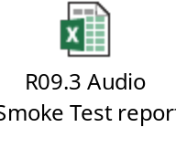
{R09.3 PRO} Fix Scope issue list
-声音幅度较大问题
-去掉快速出FM声音
-APIMCIS-24724，APIMCIS-22272同步CD764杂音问题修改
-APIMCIS-21985
Audio相关case冒烟测试结果验证pass。
有其他按键逻辑问题，同U625 APIMCIS-23629，R11版本修复。
报告如下：
Notes:
Add P1 weekly burn down chart

